Slide 1
SateLIFE
CS123 - Final Presentation
Beth Bailey, Joseph Denby, Cooper Nederhood & Laurence Warner

Slide 2
Data
Google Earth satellite data: Brazzaville and Kinshasha
1.6 billion total pixels
11 years of 6 bands
Land surface temperature
Nightlights
NDVI (vegetation index)
Landsat RGB (3 bands)
4,900 by 5,036 pixels each
~2GB, but operations can be scaled up to larger sizes
GPS coords from OpenStreetMaps

Slide 3
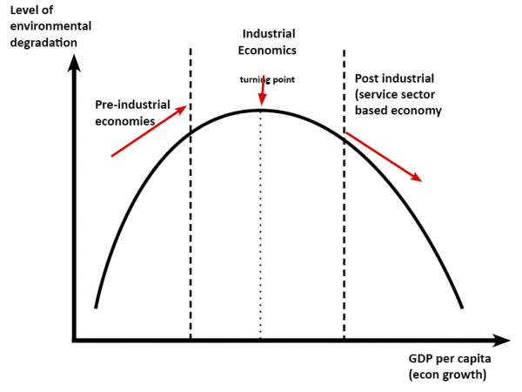
Hypothesis
Dramatic growth and urbanization == environmental degradation
Kuznet’s Curve
Expect these cities to be on the left side of the curve
Neighborhood Analysis
There may be different trends in different neighborhoods

Slide 4
Bash Scripting
Automating VM initialization

Slide 5
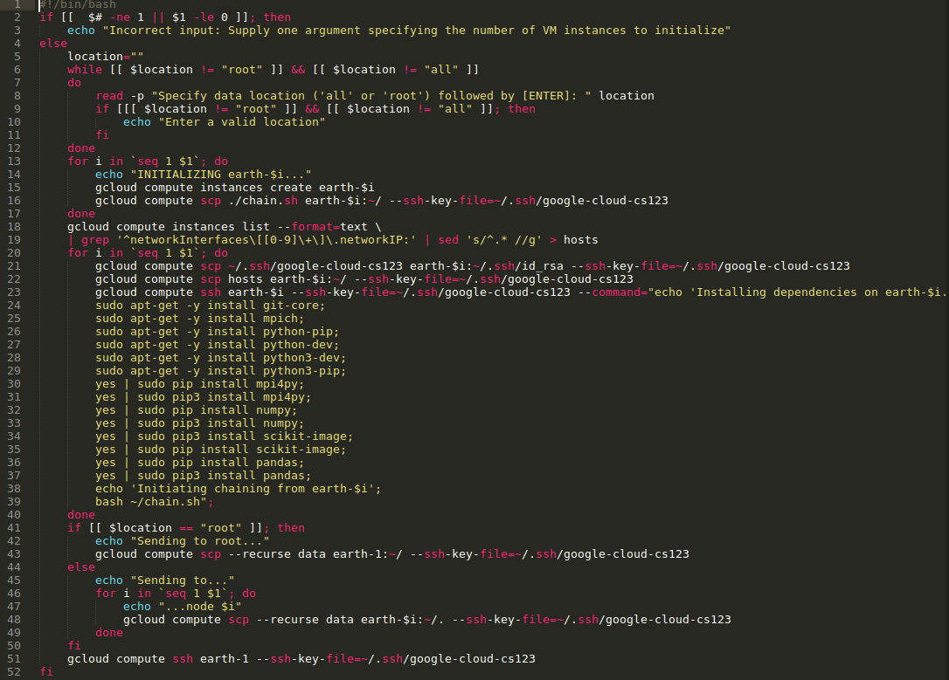


Slide 6
Data Analysis
MPI and Numpy

Slide 7
MPI
Data in tiff file format, used class to build into 3D Numpy arrays
Size = [4,900, 5,036, # of bands]
Also array of neighborhood boundaries (size = [4,900, 5,036])
Scattered chunks of these arrays to nodes
Used MPI (scatter, gather, broadcast) to do operations on each node
Numpy operations are very efficient (sum, max, min, etc.)
Some analysis of all the pixels took less than 5 minutes (faster using MPI)
Neighborhood analysis harder
Looped over data
Used dictionaries to store neighborhood values
~1.5hrs on local machine with two cores for our dataset

Slide 8
Results & Visualization

Slide 9
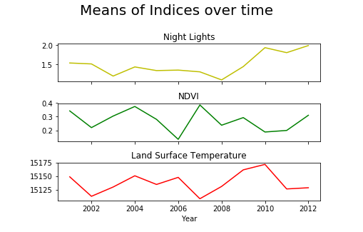
Section 1. Area-wide analysis of different bands

Slide 10
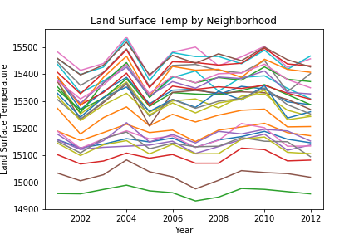
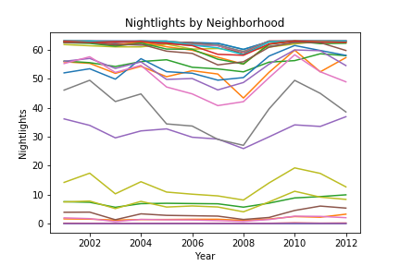
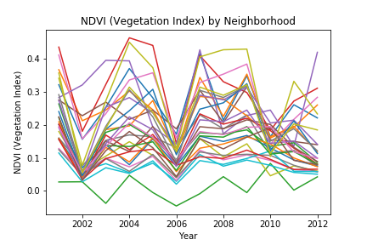
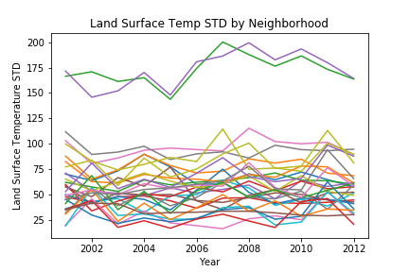
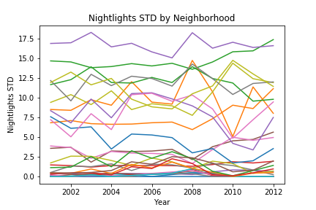
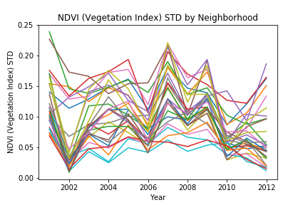
Section 2. Neighborhood Comparison
LAND SURFACE TEMP
NIGHTLIGHTS
NDVI
Notes:
Limete, Masina, and river are lowest land surface temperature
Limete and Masina - have wetland and urban areas (with one of the biggest markets)
Masina Nightlights (and river) - high stds

Slide 11
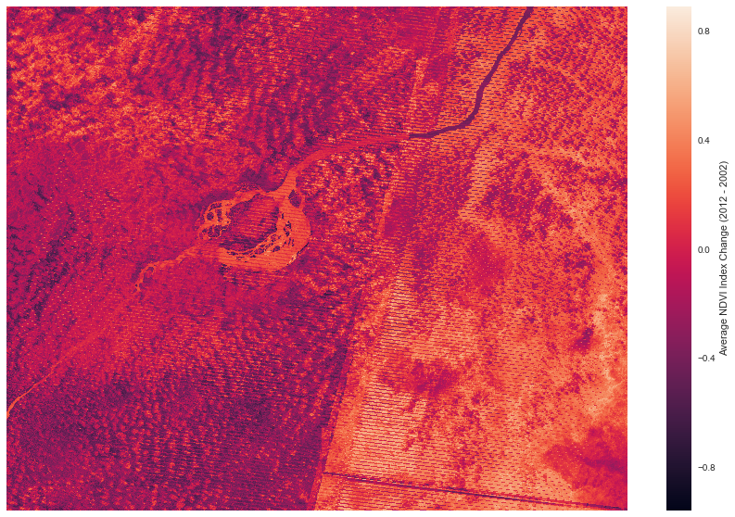
Section 3. Change Over Time: NDVI (Vegetation)

Slide 12
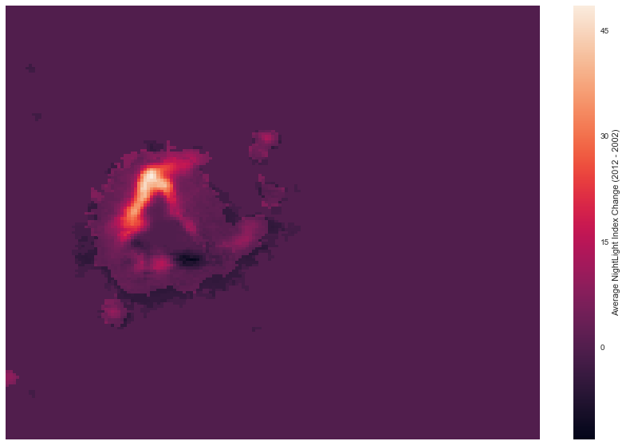
Change Over Time: Night Lights Index

Slide 13
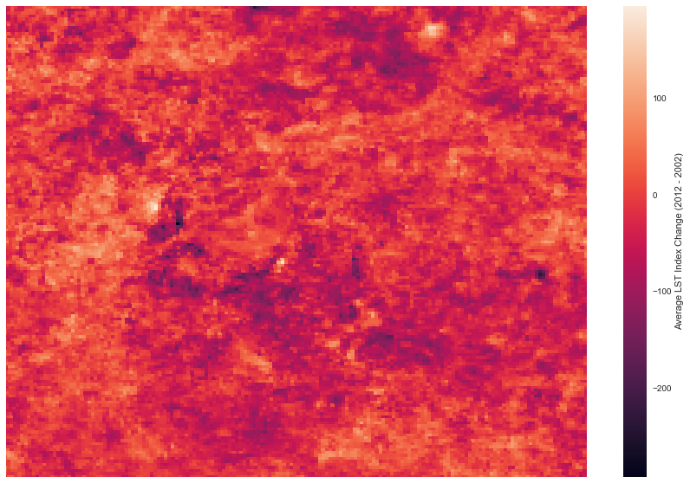
Change Over Time: Land Surface Temperature

Slide 14
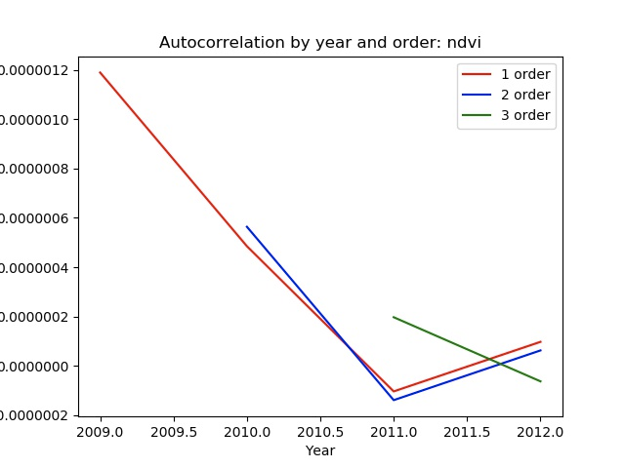
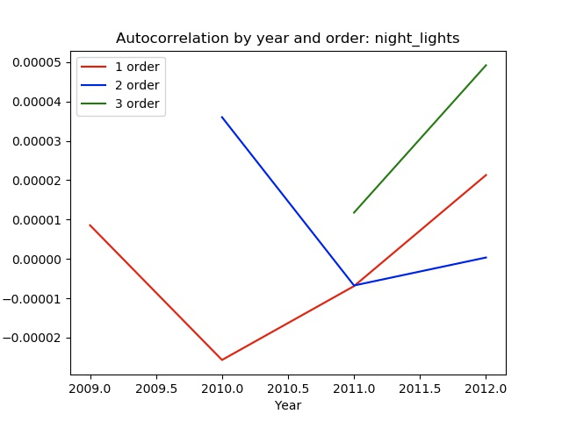
Section 4. Autocorrelation through time

Slide 15
Challenges

Slide 16
Challenges
Unstructured data: getting google earth data into useable format
SatData class structure
Annoyance of continually booting up and interfacing with VM instances
Bash scripts
Memory issues
Larger memory
Processing sections separately

Slide 17
Questions?

